Slide 1
Computer Modeling and Simulation
Lectures 7 & 8

Slide 2
SYSTEM DYNAMICS MODELS WITH INTERACTIONS
Competition is the struggle between individuals of a population or between species for the same limiting resource.
If one individual (species) reduces the availability of the resource to the other, we term that type of competition exploitative, or resource depletion. This interaction is indirect and may involve removal of the resource or denial of living space.
If there is direct interaction between individuals (species), where one interferes with or denies access to a resource, we term that competition interference. In this form, there may be physical contests for

Slide 3
Modeling Competition
Sometimes two species are not eating each other but are competing for the same limited food source.
For example, whitetip sharks (WTS) and blacktip sharks (BTS) in an area might feed on the same kinds of fish in a year when the fish supply is low.
A large increase in one species, such as BTS, might have a detrimental effect on the ability of the other species, such as WTS, to obtain an adequate amount of food and, therefore, to thrive.
Also, we expect that superior hunting skills of one species would diminish the food supply for the other species.
As one species grows, the other shrinks, and vice versa

Slide 4
Modeling Competition
In an unconstrained growth model, which ignores competition and limiting factors, we consider a population’s (P) births to be proportional to the number of individuals in the population (r₁P) and its deaths to follow a similar proportionality (r₂P).
Thus, in this model, the rate of change of the population is
dP/dt = r₁P – r₂P = (r₁ – r₂)P
The solution is an exponential function, P = P₀e^{(r1 – r2)t}.
However, with competition, a competing species has a negative impact on the rate of change of a population.
In this situation, we can model the number of deaths of each species as being proportional to its population size and the population size of the other species.
Thus, for B being the population of BTS and W the population of WTS, the number of deaths of each species is proportional to the product BW.
Moreover, the constant of proportionality associated with this proportionality for one species reflects competitive skills of the other species.

Slide 5
Modeling Competition
In this situation, we can model the number of deaths of each species as being proportional to its population size and the population size of the other species.
Δ(deaths of WTS) = wBW, where w is a WTS death proportionality constant
Δ(deaths of BTS) = bWB where b is a BTS death proportionality constant

Slide 6
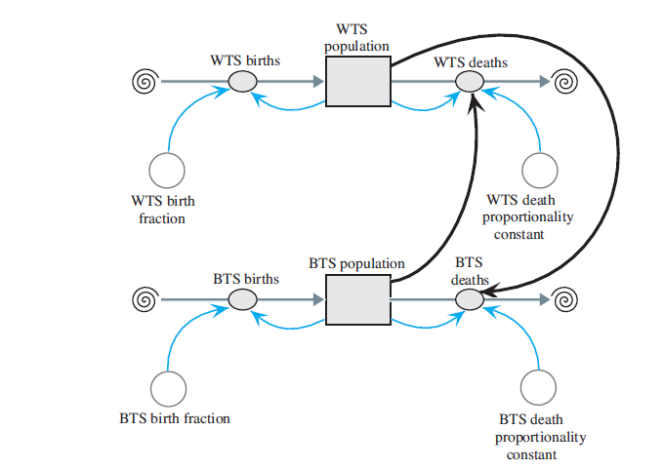
Model diagram of competition of species

Slide 7
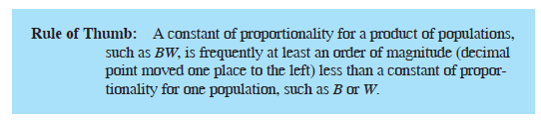
Equation Set
BTS_population(0) = 15
BTS_birth_fraction = 1
BTS_births = BTS_birth_fraction * BTS_population
BTS_death_proportionality_constant = 0.20
BTS_deaths = (BTS_death_proportionality_constant * WTS_population) * BTS_population
WTS_population(0) = 20
WTS_birth_fraction = 1
WTS_births = WTS_population * WTS_birth_fraction
WTS_death_proportionality_constant = 0.27
WTS_deaths = (WTS_death_proportionality_constant * BTS_population) * WTS_population

Slide 8
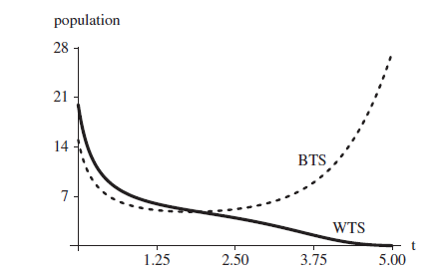
Graph of population change of BTS and WTS over time

Slide 9
Predator-Prey Model
When one species (predator) consumes another species (prey) while the latter is still living, the action is predation.
Predator adaptations usually involve better prey detection and capture, whereas prey adaptations normally involve improved abilities to escape and avoid detection.
In the 1920s, mathematicians Vito Volterra and Alfred Lotka independently proposed a model for populations of a predator species and its prey, such as hawk and squirrel populations in a certain area.
This model is called Lotka-Volterra Model.

Slide 10
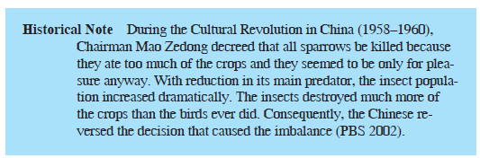

Slide 11
Lotka-Volterra Model
Let s be the number of squirrels in the area and h be the number of hawks. If no hawks are present, the change in s from time t – Δt to time t is
Δs = s(t) – s(t - Δt)
= (squirrel growth at time t – Δt) * Δt
= k_{s} * s(t – Δt) * Δt for constant k_{s}
However, this prey’s population is reduced by an amount proportional to the product of the number of hawks and the number of squirrels, h(t – Δt) * s(t – Δt). Thus, with a proportionality constant k_{hs} for this reduction, the change in the number of squirrels from time t – Δt to time t is as follows:
Δs = s(t) – s(t – Δt)
= (squirrel growth at time t – Δt) * Δt
= (k_{s} * s(t – Δt) – k_{hs} * h(t – Δt) * s(t – Δt)) * Δt

Slide 12
Lotka-Volterra Model
Δh = h(t) – h(t – Δt)
= (hawk growth at time t – Δt) * Δt
= (k_{sh} * s(t – Δt) * h(t – Δt) – k_{h} * h(t – Δt)) * Δt
Although the deaths of the squirrels and the births of the hawks are both proportional to the product of the number of possible interactions of the two populations, their constants of proportionality, k_{hs} and k_{sh}, respectively, are probably different. For instance, 2% of the possible interactions might result in the death of a squirrel, while only 1% of the possible interactions might contribute to the birth of a hawk.

Slide 13
Lotka-Volterra Model
We can express the predator-prey model, known as the Lotka-Volterra model,
as the following pair of difference equations for the change in prey (here, change in
the squirrel population, Δs) and change in predator (here, change in the hawk population, Δh) from time t – Δt to time t:
Δs = (k_{s} * s(t – Δt) – k_{hs} * h(t – Δt) * s(t – Δt)) * Δt
Δh = (k_{sh} * s(t – Δt) * h(t – Δt) – k_{h} * h(t – Δt)) * Δt
ds/dt = k_{s} s – k_{hs}hs
dh/dt = k_{sh} sh – k_{h} h

Slide 14
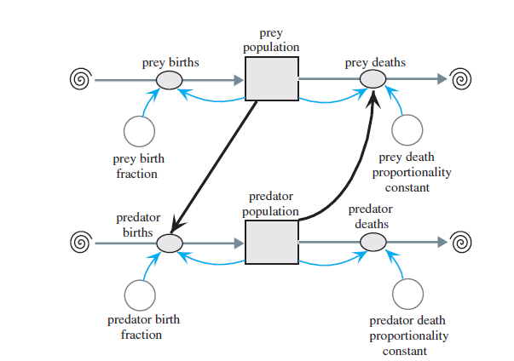
Lotka-Volterra Model
Predator-prey diagram

Slide 15
Equation set
predator_population(0) = 15
predator_birth_fraction = 0.01
predator_births = (predator_birth_fraction * prey_population) * predator_population
predator_death_proportionality_constant = 1.06
predator_deaths = predator_death_proportionality_constant * predator_population
prey_population(0) = 100
prey_birth_fraction = 2
prey_births = prey_birth_fraction * prey_population
prey_death_proportionality_constant = 0.02
prey_deaths = (prey_death_proportionality_constant * predator_population) *
prey_population

Slide 16
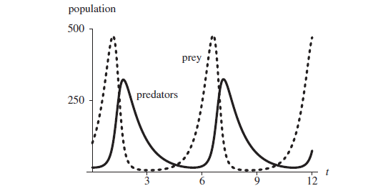
Graph of populations versus time in months

Slide 17
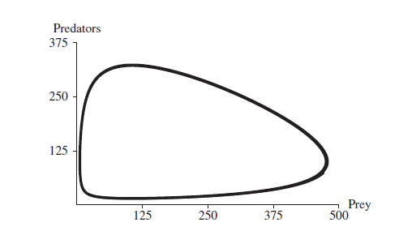
Graph of predator population versus prey population

